Slide 1

Week 2
State, Planning & Flow Engineering
Building Robust, Stateful Agentic Systems

Slide 2

Week 2 Agenda
•
Part 1: The Shift to Stateful Agents
•
Part 2: Flow Engineering Deep Dive
•
Part 3: The Planning Pattern (Travel Agent)
•
Part 4: Reflection & Self-Correction (Code Agent)
•
Part 5: Tool Routing & SLMs
•
Part 6: Lab & Assignments
Goal
Move from simple loops to complex, directed graphs of thought.

Slide 3

Agentic AI Module 4 weeks Agenda
Week1:Agentic Core Fundamentals
Week2: Agentic Patterns & Flow Engineering
Week3: Stateful Multi-Agents, GenAI Frameworks
Week4: Deployment, Security, and Governance

Slide 4
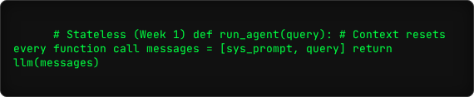
The Problem: Stateless Amnesia
Week 1 Limitation
Our ReAct agents were "Goldfish." They solved a task and forgot everything immediately.
Risks of Statelessness:
•
No continuity across sessions.
•
Cannot handle tasks requiring multi-day waits.
•
Loses context in long conversation chains.

Slide 5


Solution: Introducing State
State is the Memory of the agent. It persists data *between* the LLM calls.
User Context
Task State
World State
Preferences, Name, History.
Current Step, Completed Items.
API Results, File Contents.

Slide 6

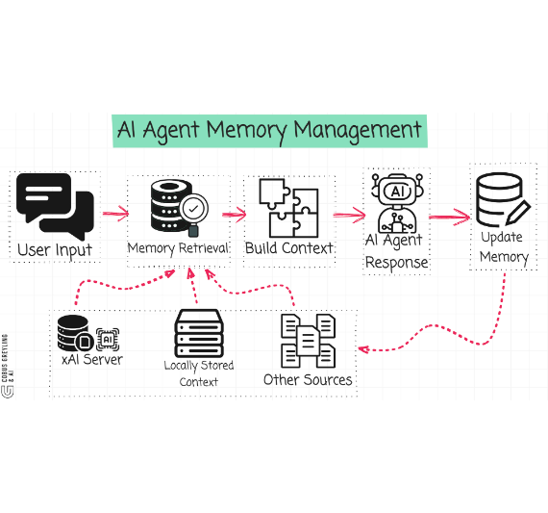
Anatomy of a Stateful Agent
A stateful agent is no longer just a function. It is a Class or an Object.
•
Schema: Defined structure (JSON/Pydantic).
•
Persistence: Saved to DB (Postgres/Redis).
•
Updates: Modified by tool outputs.

Slide 7


Types of Agent Memory
Short-term
Long-term
Episodic
Context Window
Vector DB (RAG)
Checkpoints
The active conversation history. Fast but limited (128k tokens).
Retrieving documents from the past. Infinite but slower.
Saving the "State Object" at specific steps (Time Travel).

Slide 8
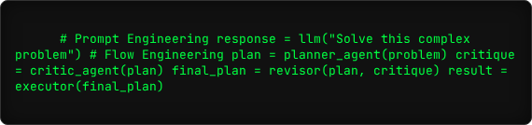
What is Flow Engineering?
"Designing the Graph of execution, not just the Prompt."
•
Break tasks into atomic steps.
•
Hard-code the logic *between* the LLM calls.
•
Reduces error rates by isolating failure points.

Slide 9


Prompt vs. Flow Engineering
Prompting
Flows
One giant instruction block.
Chained, modular steps.
Pros: Fast to write.
Pros: Robust, testable, observable.
Cons: Hard to debug, fragile.
Cons: More code to maintain.

Slide 10
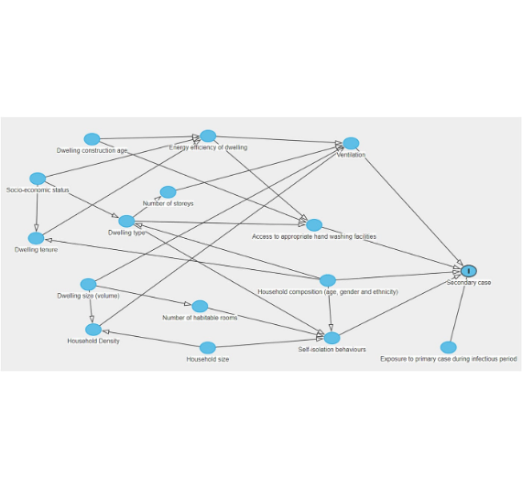
The Directed Acyclic Graph (DAG)
We visualize agent logic as a graph.
•
Nodes: Agents or Tools (Do work).
•
Edges: Logic or Data (Pass state).
•
Conditional Edges: If/Else routing.

Slide 11
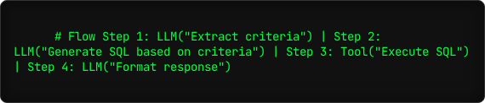
AWS Pattern 1: Prompt Chaining
The Chain
Breaking a complex task into a linear sequence of steps where the output of one step becomes the input of the next.
Use Case: Tasks with strict dependencies (e.g., Generate SQL -> Execute SQL -> Summarize Result).

Slide 12

AWS Pattern 2: Routing
Intent Classification
Using a "Gateway" LLM to analyze the user's intent and route the request to a specialized downstream agent or workflow.
Use Case: Customer support (Billing vs. Tech Support), versatile assistants.
Input -> Router -> [A, B, C]

Slide 13
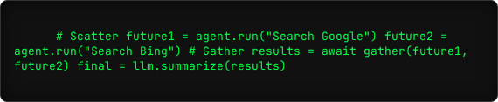
AWS Pattern 3: Parallelization
Concurrent Execution
Running multiple independent tasks simultaneously and aggregating the results.
•
Sectioning: Working on different parts of a doc at once.
•
Voting: Running the same prompt 3 times to check for consensus (Self-Consistency).

Slide 14

AWS Pattern 4: Orchestrator-Workers
Central Coordinator
A "Brain" agent breaks down a goal into tasks, assigns them to "Worker" agents, and tracks progress dynamically.
Use Case: Unpredictable, complex tasks where sub-tasks are not known in advance (e.g., Coding a feature).

Slide 15
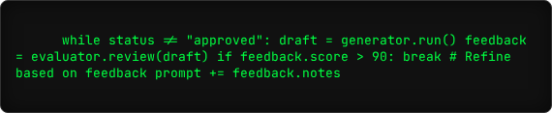
AWS Pattern 5: Evaluator-Optimizer
Quality Assurance
Generating an output (Draft) and then having a separate agent (Critic) evaluate it. If it fails, the Generator retries.
Use Case: High-stakes content generation, Code generation, Translation.

Slide 16

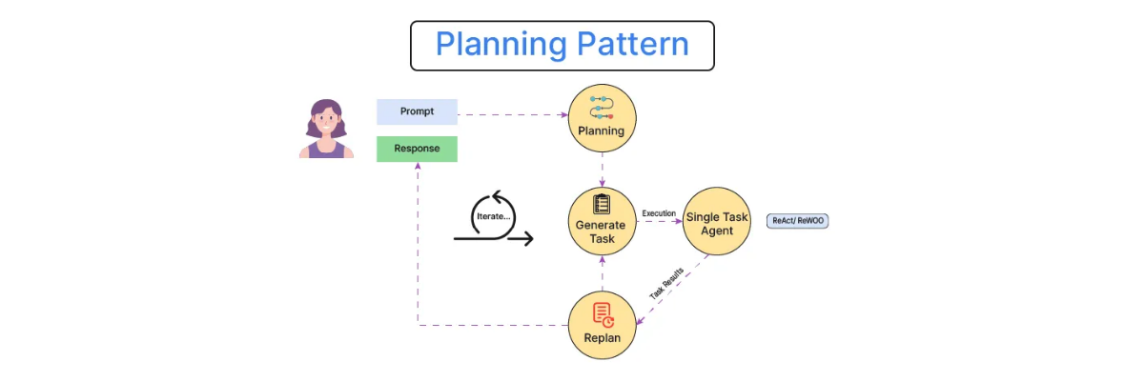
Pattern 1: The Planning Pattern
Decomposition Strategy
Complex tasks overwhelm LLMs. Planning forces them to break it down before execution.

Slide 17
Planning Types
Sequential
Parallel
Step 1 -> Step 2 -> Step 3
Step 1 & Step 2 run together -> Aggregation
Use when Step 2 depends on Step 1's output.
Use when tasks are independent.
Ex: Write code -> Run code.
Ex: Search Google for 'Apple' AND 'Microsoft' prices.

Slide 18
Use Case 1: The Travel Planner
Goal: "Plan a 3-day trip to Tokyo with a $2000 budget."

Slide 19
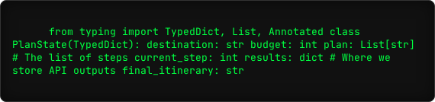
Code: Defining the State
We use a Python `TypedDict` or `Pydantic` model to enforce structure.

Slide 20
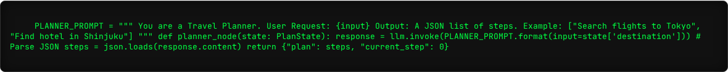
Code: The Planner Agent

Slide 21
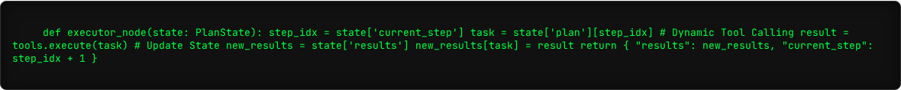
Code: The Execution Loop

Slide 22
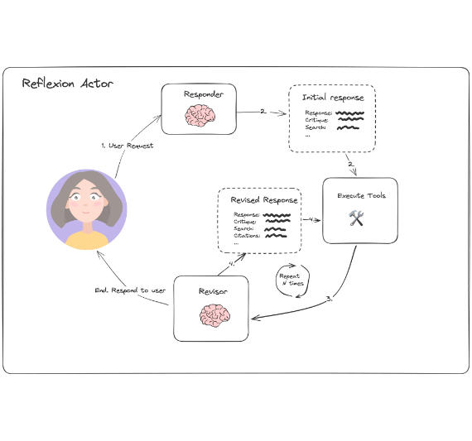
Pattern 2: Reflection & Self-Correction
System 1 vs. System 2
LLMs default to System 1 (Fast, Intuitive, Error-prone).
Reflection forces System 2 (Slow, Deliberate, Critical).

Slide 23

Why do LLMs need Reflection?
Hallucination
Code Bugs
Safety
They make things up. Critiquing catches logical fallacies.
Generated code often has syntax errors. A "Compiler" check can catch this.
Ensuring output aligns with policy (e.g., PII removal).

Slide 24
The "Reflexion" Framework
Reflexion = Generator + Verbal Reinforcement

Slide 25


Use Case 2: The Reflective Coder
Goal: "Write a Python script to scrape a website."
Process: The agent will draft code, try to run it, see the error, and fix it itself.
Actor
Critic
Writes the code.
Reads the Traceback / Error Log.

Slide 26
Code: The Generator Node

Slide 27
Code: The Critic (Validator)
*Note: In production, send code to a secure sandbox API (e2b), not exec().

Slide 28
Code: The Resolver Loop

Slide 29
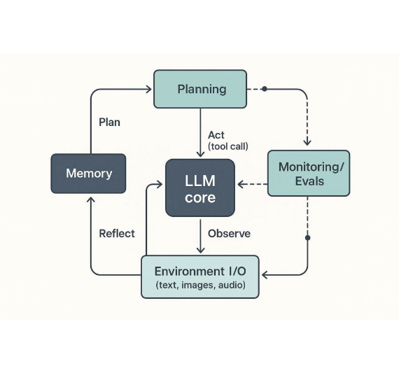
Pattern 3: Tool Routing
The Router
A specialized "Air Traffic Controller" agent.
It does not solve the problem. It classifies the input and sends it to the specialist.

Slide 30
Use Case 3: Customer Support Router
Scenario: Incoming support tickets need to go to Billing, Tech Support, or General Inquiry.
Billing
Technical
General
Refunds, Invoices.
Bugs, Login issues.
Hours, Locations.

Slide 31
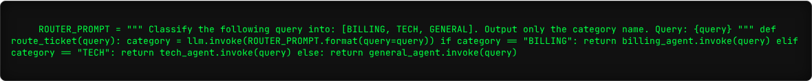
Code: The Router Implementation

Slide 32
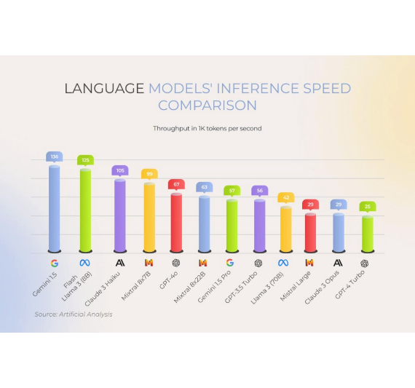
SLMs: Small Language Models
The Rise of "Tiny"
Models like Llama-3-8B, Phi-3, and Mistral are changing the game.
For specific tasks (like Routing or Summarization), they rival GPT-4.

Slide 33



The Orchestrator-Worker Pattern
Big Brain (GPT-4)
Handles Planning, Reasoning, and Complex edge cases.
Worker 1 (SLM)
Worker 2 (SLM)
Worker 3 (SLM)
Summarizer
Classifier
Extractor

Slide 34

Why use SLMs in Agents?
Cost
Latency
Privacy
Running Llama-8B is 50x cheaper than GPT-4.
Sub-second responses for tool selection.
Can run locally (Ollama) without sending data to cloud.

Slide 35
Week 2 Summary
Flow Engineering: Graph-based execution is more robust than single prompts.
•
AWS Patterns: Routing, Parallelization, and Orchestration are standard blueprints.
•
•
Planning: Breaking down tasks reduces hallucination.
•
Reflection: Self-correction loops improve quality.
Routing: Specialized agents for efficient processing.
Architecture Evolution
Week 1: Chatbot
Week 2: Autonomous Agent System

Slide 36
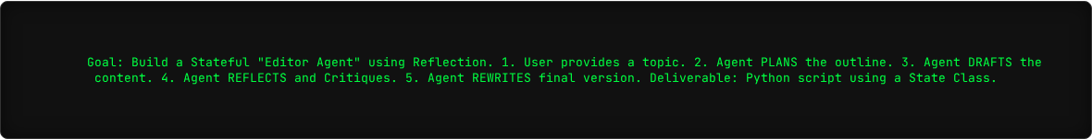
Lab Assignment: "The Editor"
Happy Coding!

Slide 37
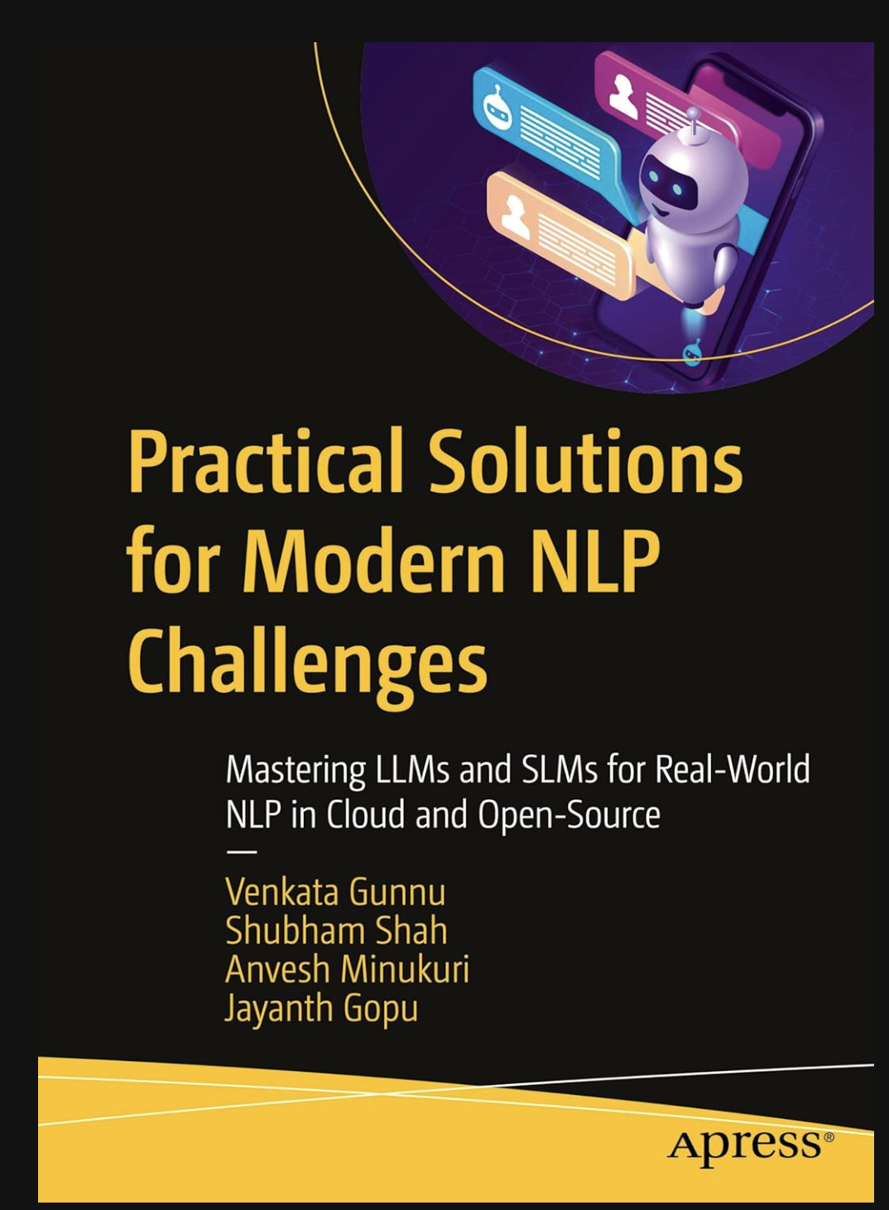


Unlock the Power of NLP with LLMs: A Practical Guide
Amazon purchase link:
Oreilly link:

